Slide 1
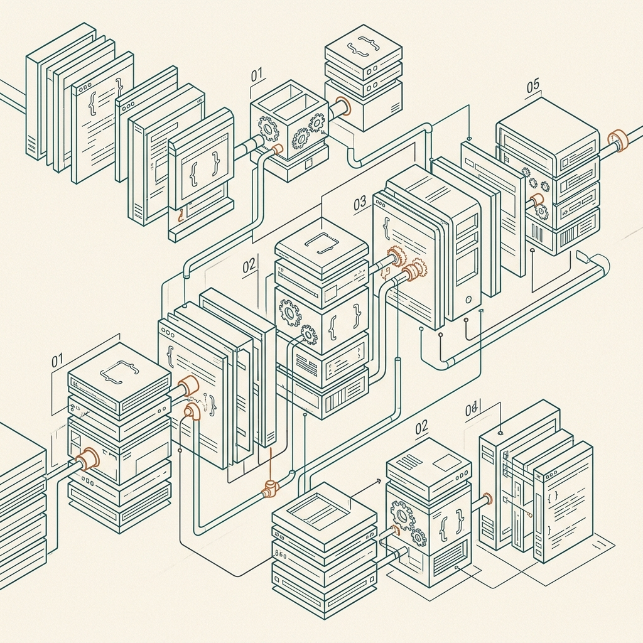
BLA_02 · SOFTWARE ENGINEERING
Software
Process Models
From Waterfall to agile, and how Netflix and Riot
Games choose their processes.
Truong Phat Tu
Master of Computer Science in Concordia University Chicago
Models: Waterfall · Incremental · Integration and configuration · Plan-driven · Agile
Cases: Netflix streaming platform · League of Legends

Slide 2



What is a software process?
PART 1
DEFINITION
WHY AN ORGANIZED PROCESS, NOT ONLY PROGRAMMING?
A structured set of activities
required to develop a software
system, together with the order in
which they happen.
Products
The outcomes of a process activity.
Typical activities include specifying a data model or designing a user
interface.
Roles
The responsibilities of the people involved in the process.
Pre- and post-conditions
Statements that are true before and after an activity is carried
out or a product is produced.
The key is quality control, process control, and management of production, cost and human resources.
Software Process Models · BLA_02 02 / 25

Slide 3





Four fundamental process activities
PART 1 · PART 6
01
02
03
04
Specification
Design and
implementation
Validation
Evolution
Defines what the system should do
and the constraints it works within.
Shows the system conforms to its
specification and meets real
customer needs.
Modifies the system after delivery as
business needs, platforms and user
requests change.
Turns the specification into a working
system.
Feasibility study
Elicitation and analysis
Requirements specification
Requirements validation
Architecture, components, interfaces
Data structures and algorithms
Coding, debugging, integrating
Reviews and inspections
Unit, system and acceptance testing
Corrective, adaptive, perfective
Reuses the existing system
Specification feeds development, development produces a system for validation, and validation results feed back into earlier work. Once
delivered, evolution restarts the cycle with new or changed requirements.
Software Process Models · BLA_02 03 / 25

Slide 4
Specification and validation in detail
PART 1
Mistakes in specification are the most expensive to fix later, which is why this stage matters so much.
SPECIFICATION INCLUDES
Feasibility study
Is the system technically and financially worth building?
Elicitation and analysis
Interviews, observation or prototypes to find stakeholder needs.
Specification
User requirements (high level) and system requirements (detailed).
Requirements validation
Check they are realistic, consistent and complete.
Verification
Validation
Testing levels
Are we building the product right?
Are we building the right product?
Unit, system, acceptance
Checks the system against its specification
through reviews and inspections of
requirements, design and code.
Checks the system meets the customer’s real
needs, including acceptance testing with the
customer.
Testing is the most common technique, but it
can only show that defects are present, not
that none remain.
Software Process Models · BLA_02 04 / 25

Slide 5




Example: QA automation in a project
PART 1
STEP 1
STEP 2
STEP 3
STEP 4
Write the tests
Run from the command
line
Run in CI/CD
Catch regressions
Tests use a framework such as
pytest with a browser automation
tool to simulate user interactions.
The same tests run in the project’s
CI/CD pipeline on every change.
Failures are caught before the code
is deployed to users.
Developers run the automated tests
in their local development
environment.
WHERE THE FOUR ACTIVITIES APPEAR
Specification
Expected user behaviour becomes test cases.
Development
Application code and test code are written together.
Validation
Automated runs verify the application behaves as specified.
Evolution
Tests rerun on each change to protect existing behaviour.
Software Process Models · BLA_02 06 / 25

Slide 6


Software process models
PART 2
A process model is a simplified description of a software
process, presented from one perspective.
Plan-driven
Agile
All process activities are planned in advance, and progress is
measured against that plan.
Planning is incremental, so it is easier to change the process to
reflect changing customer requirements.
In practice, most processes include elements of both. There are no right or wrong software processes.
Software Process Models · BLA_02 07 / 25

Slide 7
Five approaches compared
PART 2
Approach | Basic idea | How work progresses | Suited to
Waterfall | Sequential, linear phases: requirements, design, implementation, testing, maintenance. | Step by step; each stage is completed before the next begins. | Large projects with fixed, well-understood requirements, strict regulation or safety needs (aerospace, medical, infrastructure).
Incremental | Build small pieces and deliver functional components early. | Repeating cycles add features to a growing baseline version. | Evolving requirements and a need for early release or feedback (web apps, SaaS tools).
Integration and configuration | Assemble systems from off-the-shelf software, commercial packages or open-source components. | Evaluate, select, adapt and connect existing components. | Tight deadlines or budgets and standard business systems (CRM, ERP).
Plan-driven | Plan every development activity in detail before implementation begins. | Pre-scheduled milestones and formal documentation tracked against a master plan. | Long-term enterprise work, fixed-price contracts, multi-team coordination, formal certification.
Agile | Iterative, human-centered delivery with customer collaboration and fast response to change. | Short time-boxed sprints that each produce a working increment. | Startups, innovative products and customer-facing web or mobile apps.
Software Process Models · BLA_02 08 / 25

Slide 8
The Waterfall model
PART 3
01
Requirements
analysis
02
Gather and document all
functional and non-
functional needs up front.
System and software
design
03
Define architecture, data
models and component
structures.
Implementation and
unit testing
04
Code each module and verify
its basic functionality.
Integration and
system testing
05
Combine modules into a full
system and test it as a whole.
Deployment and
maintenance
WHY WATERFALL IS PLAN-DRIVEN
Rigid plan first. Development follows a pre-scheduled
plan set before any code is written.
Deliver to production, fix
remaining bugs, handle long-
term updates.
Tracked strictly. Every milestone, deliverable and
resource allocation is mapped out upfront.
Software Process Models · BLA_02 09 / 25

Slide 9



Documentation, phase gates and late change
PART 3
Documentation
Phase completion
When requirements
change late
Primary communication medium
Documents act as the contract and reference across sequential teams.
Reviewed and signed off
Each stage is fully reviewed before the next begins.
High cost and delay
Teams must re-evaluate earlier phases, re-architect components and rewrite code.
Basis for sign-off
Each phase hands the next a complete, written deliverable.
Stops defects cascading
Problems are caught at the gate, not passed downstream.
Scope and schedule disruption
Earlier documentation is invalidated, deadlines slip and total cost grows.
Software Process Models · BLA_02 10 / 25

Slide 10
Incremental development
PART 4
GROWING BASELINE ACROSS RELEASES
Break the system into pieces
Functionality is built through successive releases; each delivers a
usable subset.
Interleave the activities
The team specifies the next feature while developing current ones
and validating finished ones.
Increment 4
Increment 3
Increment 3
Increment 2
Increment 2
Increment 2
Customer feedback steers it
Customers evaluate working software after each release; feedback
shapes and prioritizes later increments.
Increment 1
Increment 1
Increment 1
Increment 1
Release 1
Release 2
Release 3
Release 4
Customer feedback after each release shapes the next increment.
Software Process Models · BLA_02 12 / 25

Slide 11



Why increments lower the cost of change
PART 4
Small, isolated pieces
Changes touch a small piece of code rather than an entire
monolithic system.
Small increments
keep change local.
Less documentation rework
Little time is wasted revising extensive documents for work
already done.
Incremental delivery also puts useful functionality
in front of customers earlier.
No re-architecting of phases
Completed work is extended instead of rebuilt in earlier
phases.
Software Process Models · BLA_02 13 / 25

Slide 12


Integration and configuration
PART 5
Build the system by reusing existing software, components, frameworks, services or
configurable systems instead of writing everything from scratch.
01
02
03
04
05
Requirements
specification
Discovery and
evaluation
Requirements
refinement
Configuration and
adaptation
Integration
Connect the components and
services into one system.
Outline the requirements without
fixing every detail.
Find candidate software and judge
how well it fits.
Adjust requirements to what the
discovered software offers.
Configure the chosen system or
adapt components to fit.
Advantage
Limitation
Faster delivery at lower cost and risk, because proven software is reused.
Requirements may need compromise, and the team has less control over
how reused components evolve.
Software Process Models · BLA_02 14 / 25

Slide 13



Evolution: engineering continues after delivery
PART 6
THREE KINDS OF EVOLUTION
60%+
Corrective
Fixing faults found after delivery.
Adaptive
of total software cost goes to
maintenance
Adjusting to a changed environment such as a new operating system
or hardware.
Figure from the lab notes. Software
production is development plus
maintenance.
Perfective
Adding or improving functions and performance.
Software Process Models · BLA_02 05 / 25

Slide 14



Coping with change
PART 7
Change is inevitable
Prototyping
Incremental delivery
In all large software projects
Supports change anticipation
Supports change avoidance and tolerance
Business changes lead to new and changed requirements.
A version of the system, or part of it, is built quickly to check requirements and design feasibility.
Increments go to the customer for comment and experimentation.
New technologies open up better ways to implement the system.
Customers receive useful functionality earlier.
Requirements: elicitation and validation.
Feedback from each increment informs what is built next.
Changing platforms require application changes.
Design: explore options and develop the UI.
Change causes rework plus the cost of new functionality.
Testing: run back-to-back tests.
Software Process Models · BLA_02 15 / 25

Slide 15




How change affects a project
PART 7
Cost
Rework such as re-analysing requirements, plus the cost of implementing the new functionality.
Schedule
Rework and re-planning push back delivery dates and can disturb milestones.
Testing
Changed code must be retested, with regression checks to catch side effects.
Documentation
Requirements, design and user documents must be updated to stay consistent with the system.
Software Process Models · BLA_02 16 / 25

Slide 16
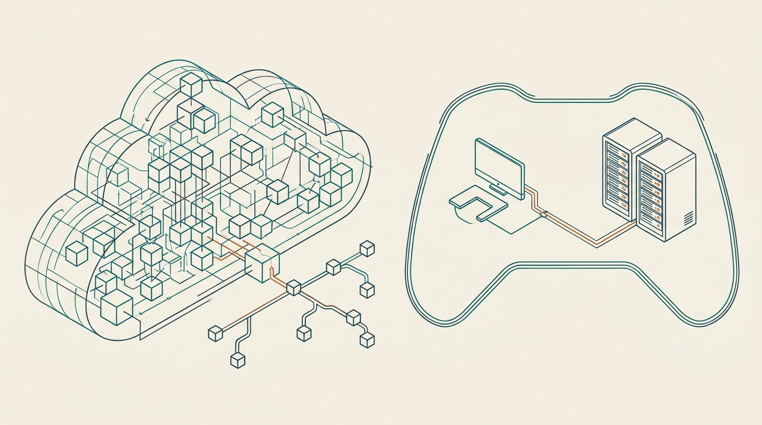
Two real-world systems
PART 8
STREAMING PLATFORM · NETFLIX
Netflix streaming service
A cloud-based multimedia platform that delivers continuous
high-definition video on demand to thousands of device types
without interruption.
GAMING SYSTEM · RIOT GAMES
League of Legends
A real-time, low-latency client-server platform that
synchronizes player inputs, physics and rendering across
multiplayer matches worldwide.
Software Process Models · BLA_02 17 / 25

Slide 17








Core technical functions
PART 8
Netflix
League of Legends
Transcoding and encoding
Game client and engine
Converts raw video into many formats and bitrates for different screens and
Handles 3D rendering, animation, input and local sound on the player’s device.
speeds.
Content delivery network
Dedicated game servers
Caches popular video on edge servers near users to cut delay and buffering.
Single source of truth for match state; run game logic to prevent cheating.
Recommendation engine
Low-latency networking
Analyzes real-time behavior to personalize content suggestions.
Optimized UDP protocols process player actions in milliseconds.
Adaptive bitrate streaming
Matchmaking and lobby
Adjusts resolution mid-stream to match bandwidth and prevent buffering.
Groups players of similar skill into balanced lobbies before a match starts.
Software Process Models · BLA_02 18 / 25

Slide 18
Netflix and Riot Games side by side
PART 9
Dimension | Netflix (streaming platform) | Riot Games · League of Legends
Process orientation | Fully continuous, microservice-driven DevOps | Scheduled bi-weekly incremental release sprint cycles
Deployment cadence | Continuous: thousands of microservice pushes per day | Structured: bi-weekly global game client patches
Testing focus | Resiliency testing, chaos engineering and automated canary analysis | Balance verification, public beta playtesting (PBE) and client-server integration
Handling changes | Feature toggles and dynamic A/B routing | Incremental patches, balance hotfixes and seasonal overhauls
User feedback loop | Automated telemetry and live analytics | Community feedback, win-rate telemetry and PBE testing
Similar: both ship incrementally, rely on telemetry and automate testing. Different: Netflix deploys continuously, while Riot releases on a fixed two-week cadence.
Software Process Models · BLA_02 19 / 25

Slide 19
Process profile of each system
PART 9
Aspect | Netflix | Riot Games · League of Legends
Development approach | Microservices-based DevOps, CI/CD and agile incremental development on AWS | Hybrid agile (Scrum/Kanban) with scheduled patch-release increments
Requirements | Data-driven user stories from telemetry, A/B test metrics and feature flags | Balance data analysis, community feedback, backlog and design documents
Waterfall traits | Low: upfront planning mainly for cloud foundations and compliance baselines | Moderate: art pipelines, core engine milestones and tournament build freezes
Agile traits | High: continuous iteration, short feedback loops, rapid deployment | High: gameplay balancing, seasonal updates and rapid live hotfixes
Major advantage | High availability, fault isolation and global rollouts without interruption | Predictable update cadence with flexibility to rebalance as the meta shifts
Major challenge | Complex service orchestration, latency and distributed consistency | Creative freedom versus engine stability, regressions and legacy code debt
Software Process Models · BLA_02 20 / 25

Slide 20


Waterfall: advantages and disadvantages
PART 10
Advantages
Disadvantages
Clear structure and documentation
Inflexible to change
Comprehensive upfront specifications make scope, requirements and
deliverables easy to track.
Changing requirements mid-stream is costly once early phases are locked
in.
Predictable planning
Late validation
Timelines, milestones and budgets can be fixed before development begins.
Working software arrives late, delaying user testing and early bug discovery.
Ease of management
High upfront risk
Phase gates with formal sign-offs give clear accountability and measurable
progress.
Requirement misunderstandings can stay hidden until system testing or
deployment.
Software Process Models · BLA_02 11 / 25

Slide 21
Choosing the right approach
PART 10
Waterfall fits when
Incremental or agile fits when
Requirements are fixed, stable and fully understood.
Regulatory, safety or legal standards apply (aerospace, medical devices, defense).
Hardware and software are co-designed and hardware cannot change after production.
Requirements evolve or are uncertain.
Speed to market matters for web, mobile or cloud applications.
Rapid user feedback and continuous updates drive success.
WHY LARGE PROJECTS COMBINE MODELS
Risk across subsystems
Waterfall for hardware or compliance modules; agile for user-facing interfaces.
Scale and coordination
Upfront architecture gives many teams a baseline; each team iterates in short sprints.
Flexibility with governance
Management tracks predictable milestones while engineers adapt during implementation.
Software Process Models · BLA_02 21 / 25

Slide 22
Why successful companies differ (1 of 2)
PART 11
Factor | Netflix | Riot Games
Type of software | Thousands of loosely coupled cloud microservices; a change to one rarely breaks the app, so decoupled DevOps pipelines work. | A heavy local client plus low-latency multiplayer servers; core engine changes need tight client-server synchronization.
Team size | Thousands of engineers in hundreds of autonomous teams, each owning a service end to end. | Large cross-functional teams of engineers, artists, sound designers, QA and balance designers aligning on each patch.
Safety and security | Operational resilience and fault tolerance, with automated chaos testing in live environments. | Competitive integrity: anti-cheat and server-side validation, since sync bugs can enable exploits.
Frequency of change | Continuous, driven by live telemetry, streaming quality metrics and A/B tests. | Rapid, but channelled into predictable bi-weekly patches so players and leagues can adapt.
Software Process Models · BLA_02 22 / 25

Slide 23
Why successful companies differ (2 of 2)
PART 11
Factor | Netflix | Riot Games
Customer expectations | 24/7 uninterrupted playback, instant loading and seamless updates with no downtime. | Predictable patch cadence, polished content, detailed patch notes and notice of maintenance.
Regulation | Digital rights management, content licensing, GDPR and local streaming rules. | Age ratings (ESRB, PEGI), loot-box disclosure laws and esports governance.
Cost and risk | Downtime or degraded video is the biggest risk, so features ship behind flags with canary deployments. | A broken patch can crash clients or ruin competitive matches, so the PBE validates changes first.
Release frequency | Hundreds to thousands of production deployments every day. | A global patch every two weeks, plus instant hotfixes for urgent bugs.
Software Process Models · BLA_02 23 / 25

Slide 24
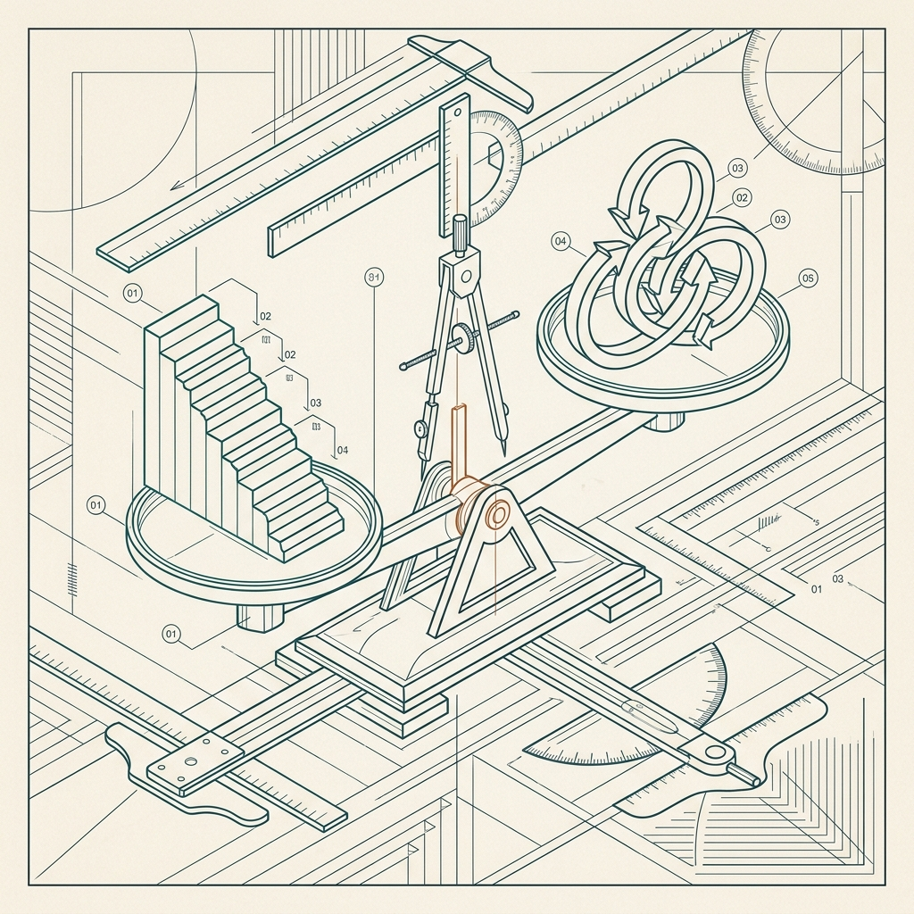



No single process fits every project
PART 11
A process succeeds when it matches the system’s
architecture, user expectations and organizational
goals.
Netflix
Cloud-native microservices thrive on continuous micro-deployments.
Riot Games
A competitive game thrives on structured, incremental releases.
Your project
Weigh software type, team size, safety, change, customers, regulation, cost
and release frequency.
Software Process Models · BLA_02 24 / 25

Slide 25
References
SOURCES
01
Royce, W. W. (1970). Managing the development of large software systems. Proceedings of IEEE WESCON, 26, 328–338.
02
Sommerville, I. (2015). Software Engineering (10th ed.). Pearson. Foundational textbook for the Waterfall model, incremental development, interleaved
specification and development, and plan-driven versus agile methods.
03
Mokhtar, R., and Khayyat, M. (2022). A comparative case study of waterfall and agile management. SAR Journal – Science and Research, 52–62.
doi.org/10.18421/sar51-07
04
F5 NGINX Developer Blog (2015). Adopting microservices at Netflix: Lessons for architectural design. F5 Networks.
05
Riot Games Engineering (2016–2021). The Riot Games API: Deep Dive, and Keeping Legacy Software Alive: A Case Study. Riot Games official news and tech
articles.
Software Process Models · BLA_02 25 / 25

